Slide 1

“Resume Analyzer using NLP”
TERNA ENGINEERING COLLEGE
DEPARTMENT OF COMPUTER ENGINEERING
B.E /Sem 7/ Div B/ Group no.13
Roll No. Group members name
B59 Amrut Mane
B47 Pranit Misal
B61 Siddhesh Navale
B60 Atharva Umap
Under the guidance of
Prof. Ramesh Shahabade
Academic Year
2022-23

Slide 2
Content
Introduction
Abstract
Literature survey
Problem Statement and Objective
Scope of the Project
Proposed System
Diagrams
Hardware and Software Requirements
Expected outcomes
References

Slide 3
Introduction
Resumes are a critical part of the job application process.
They are used by employers to asses a candidate’s skills experience and qualifications for a job.
Making a good resume acts as an important deciding factor which determines whether a candidate gets selected or not.

Slide 4
Abstract
Our main goal is to make a website that parses the resumes and helps employees by giving them tips to improve their resume.
This is where NLP can help.
NLP can be used to extract information from resumes, such as skills, experience and education and to identify keywords that are relevant to a particular job opening.

Slide 5
Literature Survey

Slide 6
Ref No. | Authors | Year | Name of the Research paper | Summary
1. | Pratibha S, Vibha Pratap, et.al. | 2022 | Resume Classifier and Summarizer. | Advanced machine learning technologies such as logistic regression and Support Vector machine learning are used. This project predicts the category of the resume and provides the summarized version of the resume.
2. | R. Bharadwaj, D. Mahajan, et.al. | 2023 | Resume Analysis using NLP. | NLP , an advanced technology, has been used. Useful information is extracted from the resume and validation is done, whether or not it is inline with the company requirements. Resume ranking is also performed by using Resume score.
3. | Preeti A. , Deepali Virmani, et.al. | 2020 | Resume Selector. | Advanced technologies such as PySpark and Hadoop have been used in this project. Hadoop is used to store terabytes of data and Pyspark is used to process those resumes parallelly in a distributed environment.
4. | Smiti Singhal, Dhara Ajhudia, et.al. | 2022 | Intelligent Recruitment System using NLP. | This project extracts data from resumes. Performs required analysis on data. Converts this data into useful information for users.

Slide 7
Ref No. | Authors | Year | Name of the Research paper | Summary
5. | Nikita Phulkar, Harsha Bhute, et.al. | 2021 | A Framework for E-Requirement System based on Text Categorization and Semantic Analysis. | Using NLP technology an autonomous text classification system has been made that POS tags, tokenizes and lemmatizes the data. Phase Matcher has been used to calculate the score of resumes. Suggest the lacking skills to users and provides the top resumes to recruiters.
6. | S. Bharadwaj, Macheria Nikhil, et.al. | 2022 | Resume Screening using NLP and LSTM | This project categorizes CVs according to the skills they contain into various job options. This project aids job seekers in evaluating what type of positions they are qualified for based on their resume skills.
7. | B Gunaseelan, Supriya Mandal, et.al. | 2021 | Automatic extraction of segments from Resumes using Machine Learning | This projects uses multi-level classification technique This project focuses on extracting detailed segment information like skillset, experience and education.
8. | Tejas Pataru, Harsha Chirumamilla, et.al. | 2023 | Resume Classification using ML Techniques | ML Techniques like Decision Tree, Random Forest, KNN, Support Vector are compared and the one with most accuracy is used. This project aims to automatically classify resumes to their corresponding suitable positions

Slide 8
PROBLEM STATEMENT
Employees often don’t know how to write resumes that are effective in getting them job interviews. This can be due to a number of factors, such as lack of experience, not knowing what employers are looking for, etc.
A resume analyser using NLP can help employees to improve their resumes by providing them with feedback on their content and formatting.

Slide 9
Aim and Objective
The main objective of our project is to make a website which parses the resumes of the users/employees extract useful information from their resumes, give the resume a resume score, give the positives and negatives of the resume as well as give personalized recommendations to the users such that they will be able to improve their resumes.

Slide 10
Limitations of Existing System
The resume analyzers that are currently there in the market are more HR/Company oriented and there is no focus on giving any sort of feedback to the user.
The main focus of current systems is to make the process of hiring as easier and there is no focus on guiding the employees to dream companies or to improvise the resumes of the employees seeking jobs.

Slide 11
Proposed System
Our system is highly user oriented which wholly focuses on giving as much feedback as possible to the employee so that the employee can take proper steps to improvise his/her resume which can in turn help the employee to prepare according to respective job requirements as well as achieve a high salary job.

Slide 12
Scope of the Project
Extracts important data using NLP.
Analyzes the resume of the user and provides the positives and negatives of the resume to the user.
Displays the current skills of the user.
Displays recommended skills to the user.
Gives personalized recommendation to user via weblinks(Courses & Certifications, YT Links).
Gives a resume score to the user.
Displays user data to the admin via graphs as well as plain excel downloadable excel sheets.

Slide 13
Methodology

Slide 14
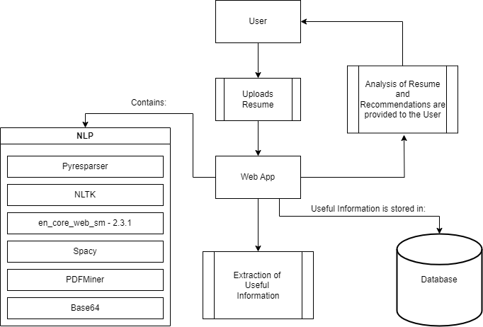

Slide 15
WIREFRAME

Slide 16
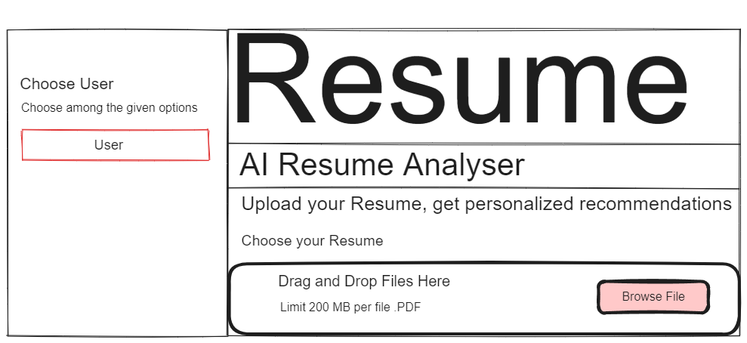

Slide 17
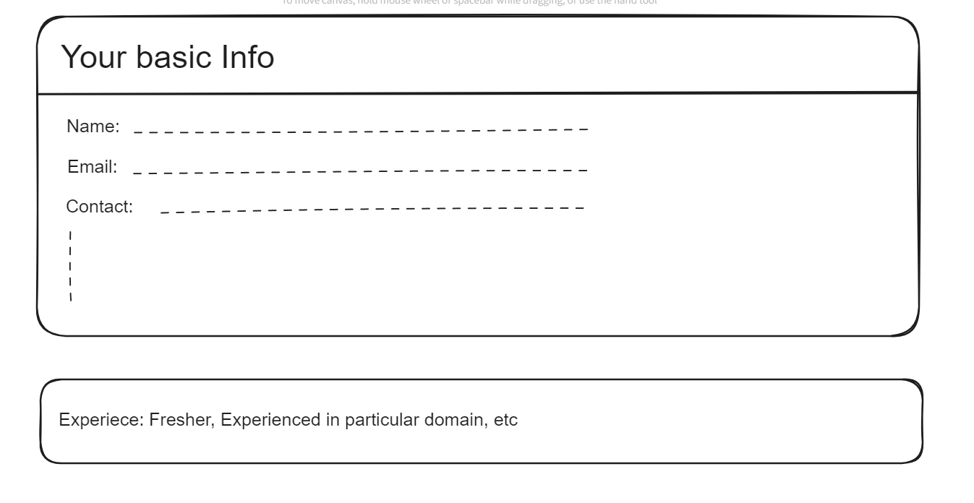

Slide 18
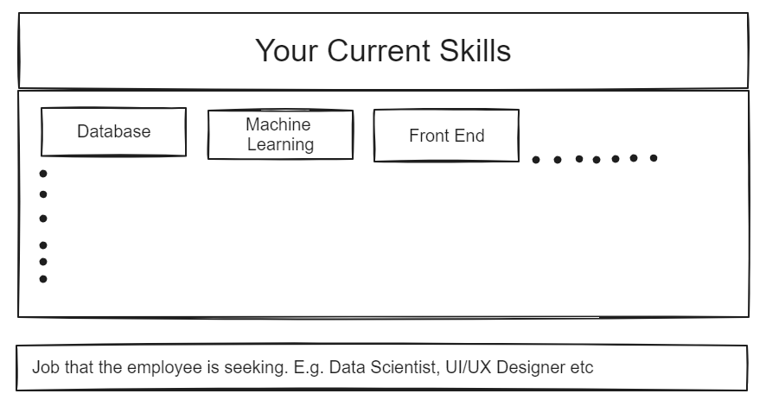

Slide 19
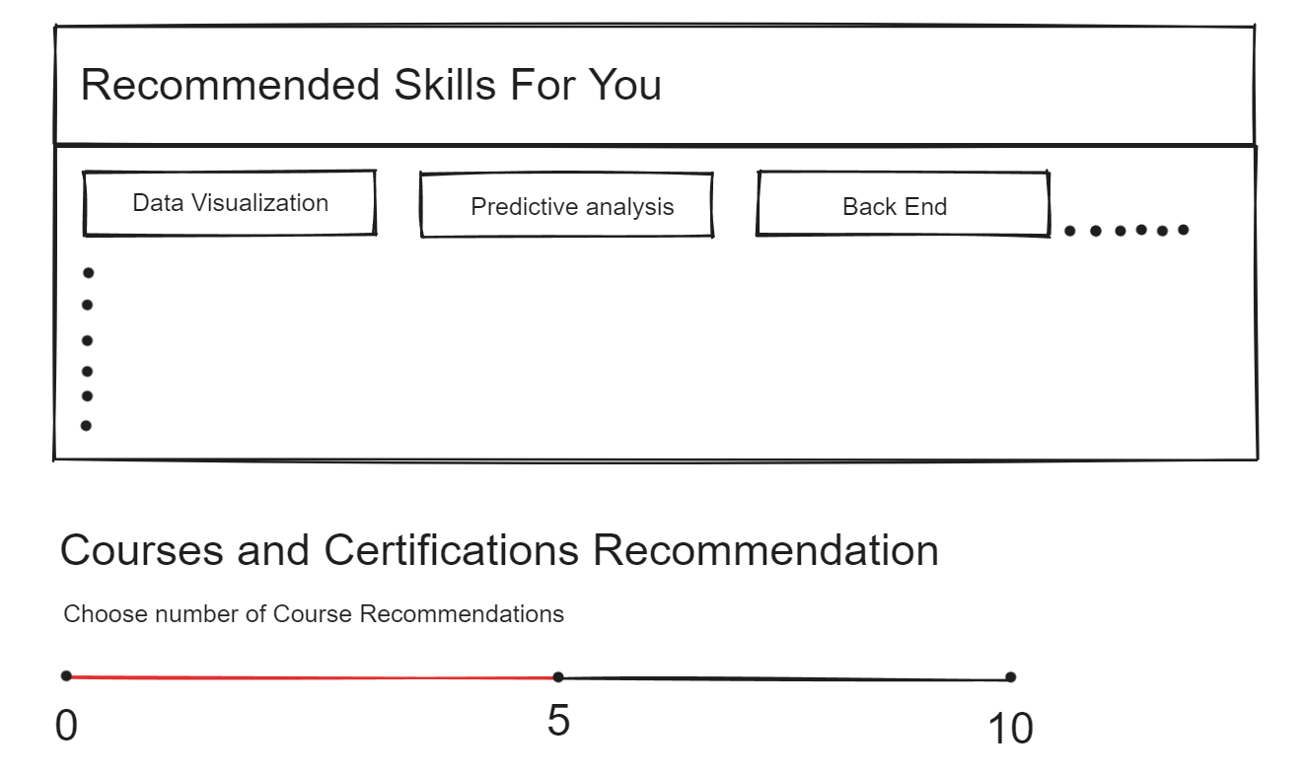

Slide 20
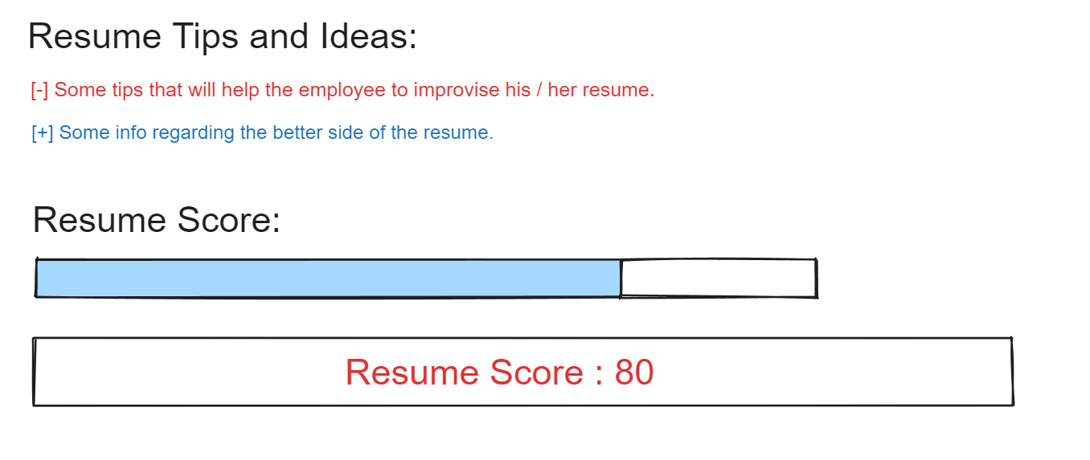

Slide 21
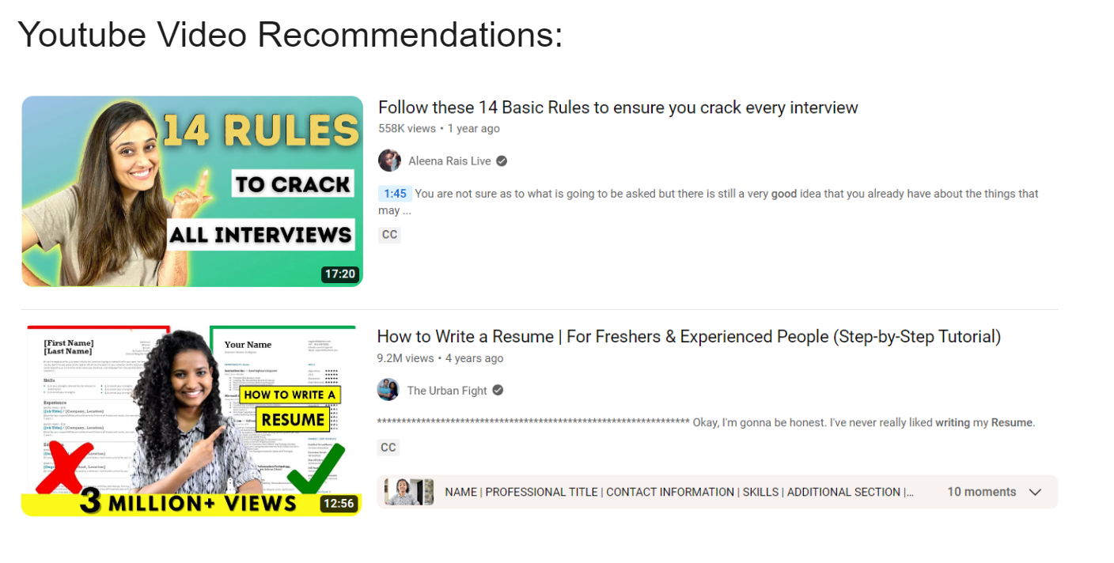

Slide 22
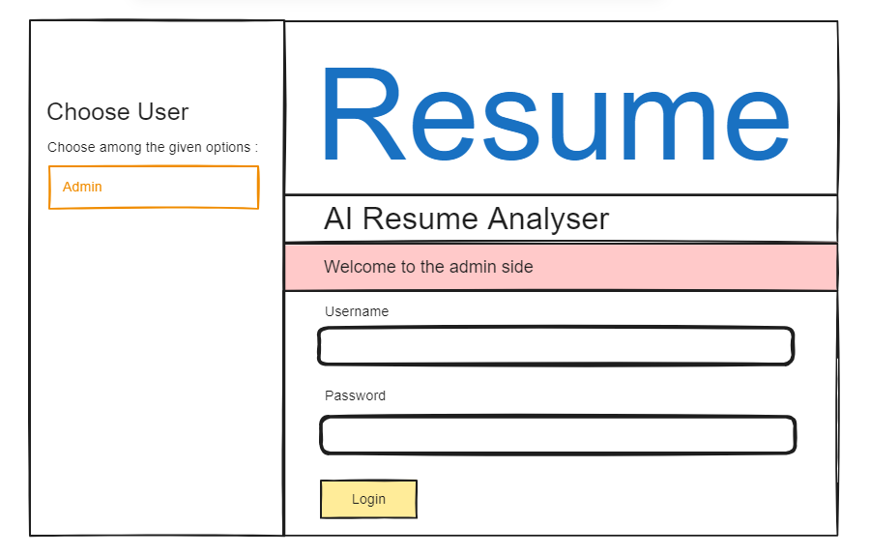

Slide 23
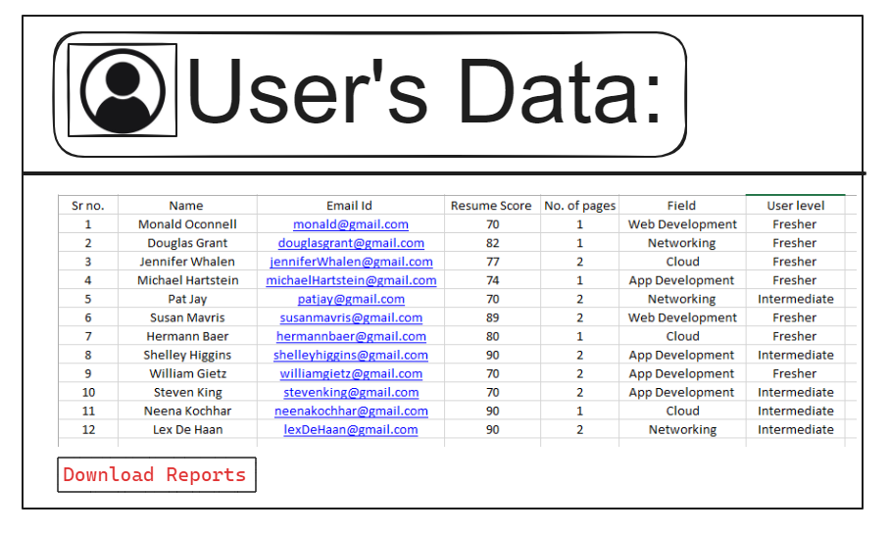

Slide 24
UML Use Case Diagram

Slide 25
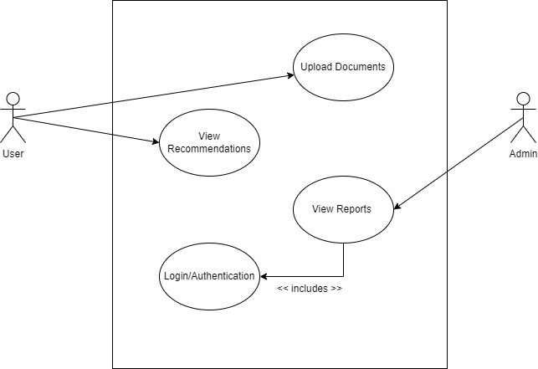

Slide 26
Flow Diagram

Slide 27
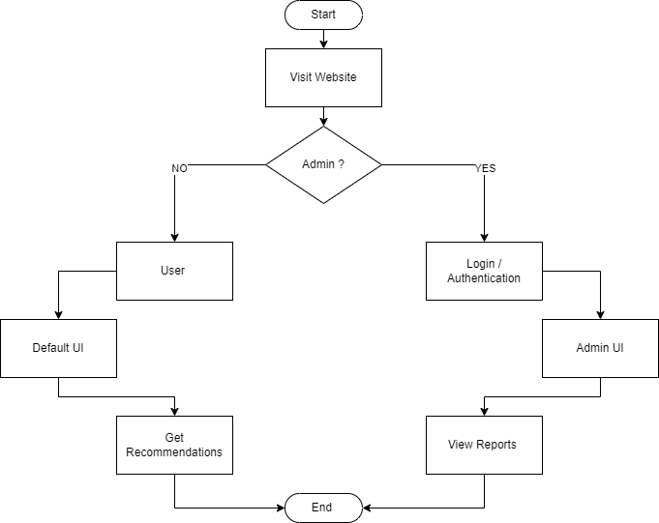

Slide 28
HARDWARE REQUIREMENTS
Processor : Ryzen 5
Memory : 8GB
GPU : Nvidia
Internet connectivity

Slide 29
SOFTWARE REQUIREMENTS
Operating System : Windows 11
Language : Python
NLP Libraries
Database : MySQL, SQL Workbench
IDE : VSCode
Dependencies : pip

Slide 30
References
[1] P. Swami and V. Pratap, "Resume Classifier and Summarizer," 2022 International Conference on Machine Learning, Big Data, Cloud and Parallel Computing (COM-IT-CON), Faridabad, India, 2022, pp. 220-224, doi: 10.1109/COM-IT-CON54601.2022.9850527.
[2] Bharadwaj, R., Mahajan, D., Bharsakle, M., Meshram, K., Pujari, H. (2023). Resume Analysis Using NLP. In: Suma, V., Lorenz, P., Baig, Z. (eds) Inventive Systems and Control. Lecture Notes in Networks and Systems, vol 672. Springer, Singapore. https://doi.org/10.1007/978-981-99-1624-5_40
[3] Arora, P., Virmani, D., Jain, A., Vats, A. (2021). “RESUME SELECTOR” Using Pyspark and Hadoop. In: Pandey, V.C., Pandey, P.M., Garg, S.K. (eds) Advances in Electromechanical Technologies. Lecture Notes in Mechanical Engineering. Springer, Singapore. https://doi.org/10.1007/978-981-15-5463-6_52

Slide 31
References
[4] A. Sharma, S. Singhal and D. Ajudia, "Intelligent Recruitment System Using NLP," 2021 International Conference on Artificial Intelligence and Machine Vision (AIMV), Gandhinagar, India, 2021, pp. 1-5, doi: 10.1109/AIMV53313.2021.9670958
[5] R. Shaikh, N. Phulkar, H. Bhute, S. K. Shaikh and P. Bhapkar, "An Intelligent framework for E-Recruitment System Based on Text Categorization and Semantic Analysis," 2021 Third International Conference on Inventive Research in Computing Applications (ICIRCA), Coimbatore, India, 2021, pp. 1076-1080, doi: 10.1109/ICIRCA51532.2021.9544102.

Slide 32
References
[6] S. Bharadwaj, R. Varun, P. S., M. Nikhil and G. C. Babu, "Resume Screening using NLP and LSTM," 2022 International Conference on Inventive Computation Technologies (ICICT), Nepal, 2022, pp. 238-241, doi: 10.1109/ICICT54344.2022.9850889.
[7] B. Gunaseelan, S. Mandal and V. Rajagopalan, "Automatic Extraction of Segments from Resumes using Machine Learning," 2020 IEEE 17th India Council International Conference (INDICON), New Delhi, India, 2020, pp. 1-6, doi: 10.1109/INDICON49873.2020.9342596.
[8] B. Surendiran, T. Paturu, H. V. Chirumamilla and M. N. R. Reddy, "Resume Classification Using ML Techniques," 2023 International Conference on Signal Processing, Computation, Electronics, Power and Telecommunication (IConSCEPT), Karaikal, India, 2023, pp. 1-5, doi: 10.1109/IConSCEPT57958.2023.10169907.

